Slide 1
Wholesale customers: The impact of region on sales of products
Artur Bruev for CS-668
17 September of 2023
https://github.com/SkySkyPa/CapstoneProjectDataset

Slide 2

Outline
Project proposal
Literature review
EDA: Relations between variables
NEO4J
Methodology and Experimentations
Conclusion and Discussion
References

Slide 3
Project Proposal
Targeted Problem
There is an acute shortage of certain products in regions of Africa. Over history, categorise like ‘milk’ and ‘grocery’ was difficult to produce. It’s impossible to build infrastructure for over 1 billion 216 million people, because of weather conditions and political issues. Last changes in climate of planet makes production of products harder for our planet, as temperature of Africa rise.
Collecting of trade data, using different datasets and analyzing them, can help to organize the redistribution of goods for more reasonable consumption. Correct analysing will lead to an improvement of situation in problem regions, by understanding the needs and company-customer habits in global trading.
Research question
How columns of trading affect on categories of products purchased?
Dataset
https://archive.ics.uci.edu/dataset/292/wholesale+customers
The data set refers to clients of a wholesale distributor. It includes the annual spending in monetary units (m.u.) on diverse product categories
Number of rows: 440, columns - 8
Motivation
This project is helping to understand logistic of items, what can improve knowledge of economic
It’s possible to achieve understanding of trades in regions, which will help to know needs of subject.

Slide 4
Literature review 1
https://www.mecs-press.org/ijitcs/ijitcs-v9-n6/IJITCS-V9-N6-4.pdf Goal: B. Jaya Lakshmi, K. B. Madhuri and M. Shashi trying to use Subspace Clustering Algorithm to identify arbitrary shaped subspace clusters. SUBCLU uses two parameters such as epsilon and minpts, which values is same. This can lead to low quality of clusters. The mission is overcome this quality by using new parameters. Dataset: Synthetic datasets and bench mark datasets. Methodology: Algorithm form one dimensional subspace clusters. Each cluster in subspace partitioned into one or more clusters in higher dimensional subspace. The higher dimensional subspace clusters are explored in the divisive hierarchical manner. Result: Both the versions of the proposed algorithm produce better quality subspace cluster.
https://ieeexplore.ieee.org/stamp/stamp.jsp?tp=&arnumber=10189373 Goal: Yuning Yang and Na Li exploring travelling of people, after coronavirus period in urban territories. Citizen’s travel choices with concept given a high and effective mode of travel among all options. This article focuses on the study of residents’ travel choice behavior under the combined effect of multiple travel characteristic factors in the current context. Dataset: Resident Travel Dataset Methodology: Pearson correlation coefficient is helping to calculate the relations between influencing factors. Concept of maximizing utility is perfect choice for consumers in a combination. Citizen’s travel choices with concept given a high and effective mode of travel among all options. Result: We can select multiple travel characteristic factors to make the travel decision-making mechanism clearly, in order to explain actual residents’ choices more accurately. Multiple logistic regression theory provides us credible method for limitedly rational decision-making in travel mode and route choices.

Slide 5
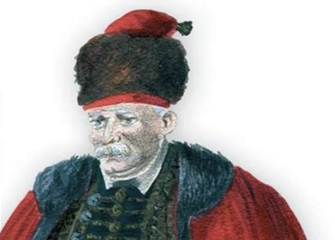
Literature review 2
https://ieeexplore.ieee.org/stamp/stamp.jsp?tp=&arnumber=9739679 Goal: Yan-Xue Wu, Zhi-Heng Hu, Yuan-Yuan Wang, Fan Min paper adopted a focus embedded logistic regression (FeLR) to solve two types of difficulties–the rarity and hard-distinguishability, of the potential poor household (PPH) identification. China completed the nationwide registration of poor population in 2013, and implemented the Targeted Poverty Alleviation (TPA) strategy to move households out of poverty by 2020. Dataset: Household datasets Methodology: authors using two formules such as prediction probability and the log-likelihood. 3 measures (from ML view) was implemented to evaluate classification results. Result: To illustrate the effectiveness of FeLR, it was compared with the traditional logistic regression.
Neo4J in Action (by Jonas Partner, Aleksa Vukotic, and Nicki Watt) Goal: It serves as a valuable resource for those interested in learning about graph databases and Neo4j in particular. The book covers a range of topics, from basic concepts to more advanced techniques, making it suitable for both beginners and experienced users of Neo4j.
Dataset: Cases product by code
Methodology: It likely follows a structured approach to gradually build the reader's knowledge and skills in working with Neo4j and graph databases.
Result: Aims to empower readers with the knowledge and practical skills needed to harness the power of graph databases and Neo4j for their data management and application development needs. It serves as a valuable resource for both beginners and experienced users looking to leverage the benefits of graph databases in their projects.

Slide 6
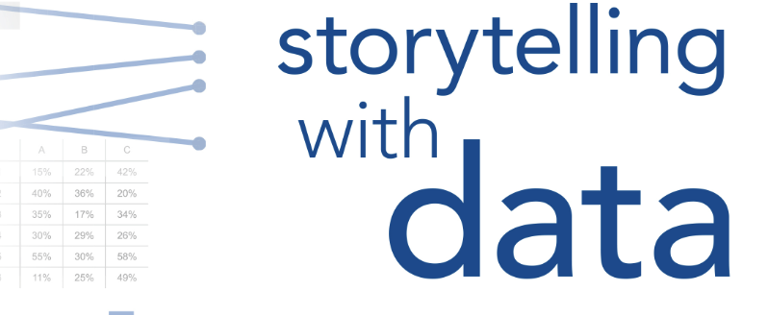

Literature review 3
Storytelling with data: a data visualization guide for business professionals Goal: Cole Nussbaumer Knaflic explain several rules, for project presentation. Using of this commands, helps to explain an ideas clearly. As presentation and storytelling are core skills for different professions. Understand of creating plots and graphs is not enough to be a good Data Professional nowadays.
Dataset: Examples of different data visualizations.
Methodology: 8 chapters given several recommendations, how to visualize data correctly, improving your presentation skills.
Result: Data visualization sits at the intersection of science and art. There are often potential paths for communicating effectively with data. After the course, student learns a great deal of new rules
Fundamentals of Data Visualization:
A primer on making Informative and Compelling Figures Goal: Claus O. Wilke is primarily focused on teaching the principles and techniques of effective data visualization, to educate and empower individuals to create informative and compelling data visualizations that enhance data communication, understanding, and decision-making in a wide range of fields.
Dataset: Different visualization cases
Methodology: Book is centered around teaching and illustrating the principles and techniques of effective data visualization. It is rooted in a pedagogical approach, aiming to educate readers about the principles of data visualization, provide them with practical skills, and empower them to create informative and compelling data visualizations for their own work.
Result: Student understand, how to build correct Data Visualizations.

Slide 7
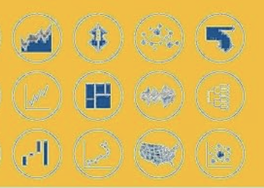
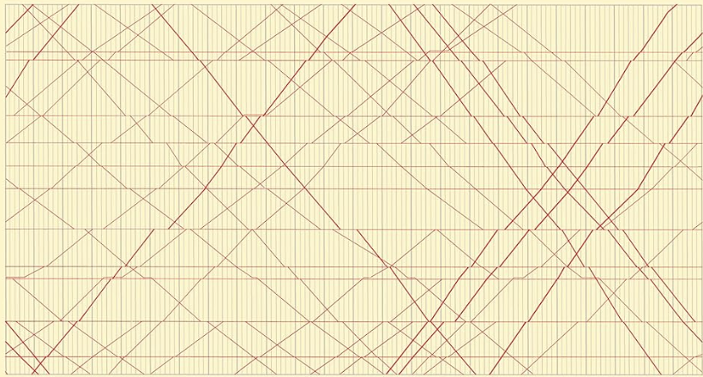
Literature review 4
Better Data Visualizations: A Guide for Scholars, Researchers, and Wonks Goal: to equip scholars, researchers, and professionals with the knowledge and skills needed to create clear, impactful, and ethically sound data visualizations that enhance understanding and decision-making in their respective domains.
Dataset: Examples of different data visualizations.
Methodology: is rooted in practicality and accessibility. It combines foundational concepts, practical guidance, real-world examples, and hands-on activities to equip scholars, researchers, and professionals with the tools to create informative and compelling data visualizations that enhance communication and decision-making.
Result: can lead to improved data communication, enhanced visualization skills, ethical data practices, and greater confidence in presenting data effectively.
The visual display of quantitative information Goal: Edward R. Tufte is trying to educate and empower readers to create informative, honest, and visually compelling data visualizations that enhance understanding and facilitate data-driven decision-making. The book has had a profound impact on the field of data visualization and continues to be a valuable resource for professionals and enthusiasts alike.
Dataset: Examples of different data visualizations.
Methodology: principled, illustrative, and rooted in fundamental principles of data visualization. It encourages a thoughtful and responsible approach to designing data graphics that prioritize clarity, accuracy, and effective communication of quantitative information.
Result: Reader educate to a professional data visualization.

Slide 8
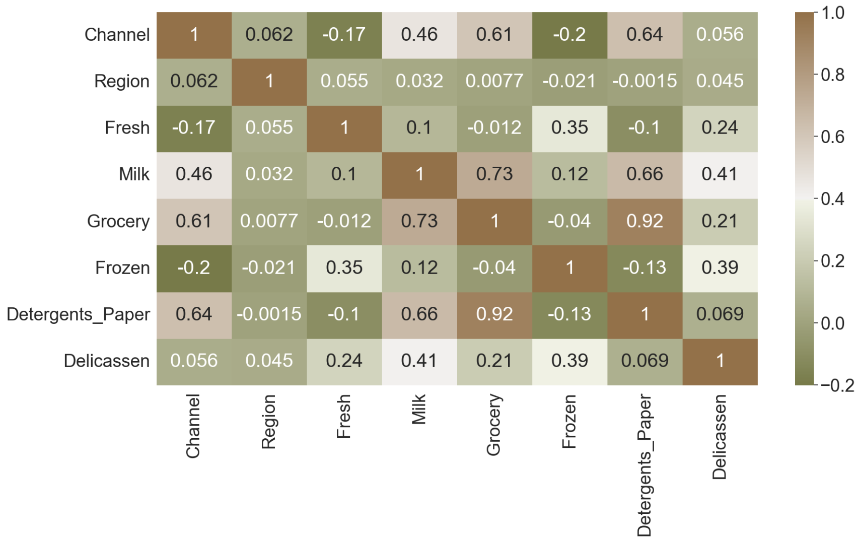
EDA
Relations between variables
0.92 Detergents_Paper - Grocery 0.66 Detergents_Paper - Milk 0.64 Detergents_Paper - Channel
0.73 Grocery - Milk 0.61 Grocery - Channel
0.46 Channel - Milk 0.062 Channel - Region
0.055 Region - Fresh 0.35 Fresh - Frozen
0.12 Milk - Frozen
0.39 Delicassen - Frozen 0.24 Delicassen - Fresh
1) FRESH: annual spending on fresh products;
2) MILK: annual spending on milk products;
3) GROCERY: annual spending on grocery products;
4) FROZEN: annual spending on frozen products;
5) DETERGENTS_PAPER: annual spending on detergents and paper products;
6) DELICATESSEN: annual spending on and delicatessen products;
7) CHANNEL: Hotel/Restaurant or Retail channel (Nominal)
8) REGION: Territory/Area from which data was collected
Dataset contains 8 columns.
Dataset is clean, and have no need in pre-processing
Dataset don’t contain any NULL values
Datatype of each data is already complete

Slide 9
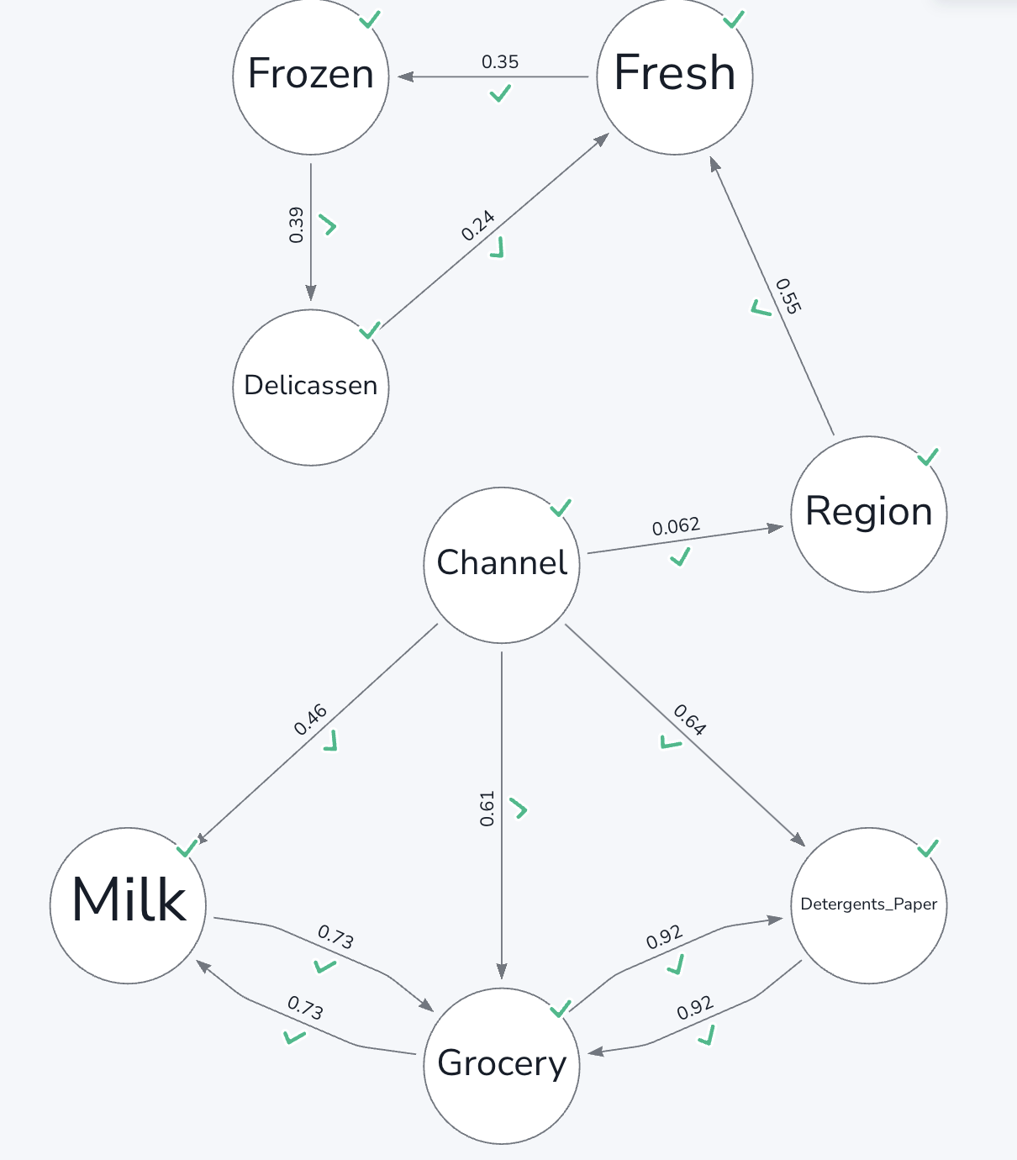
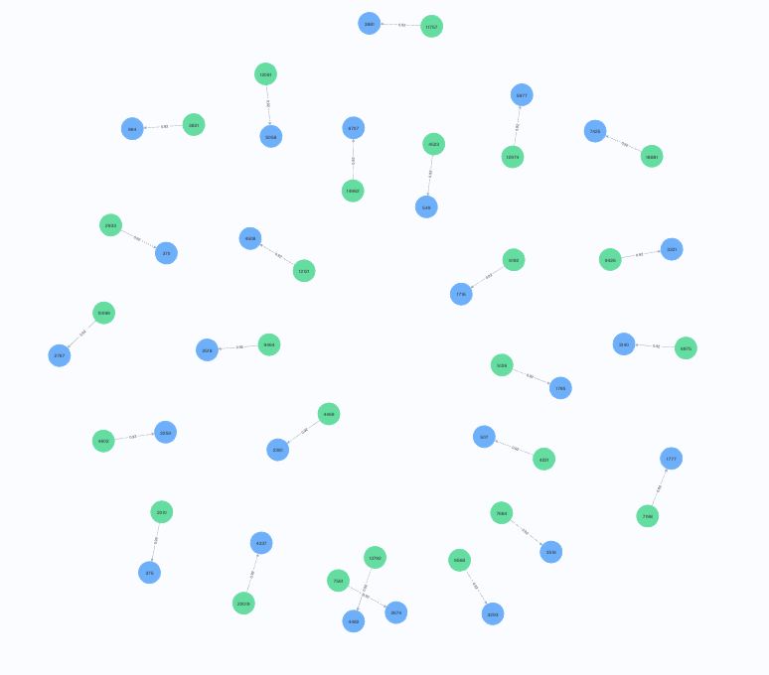
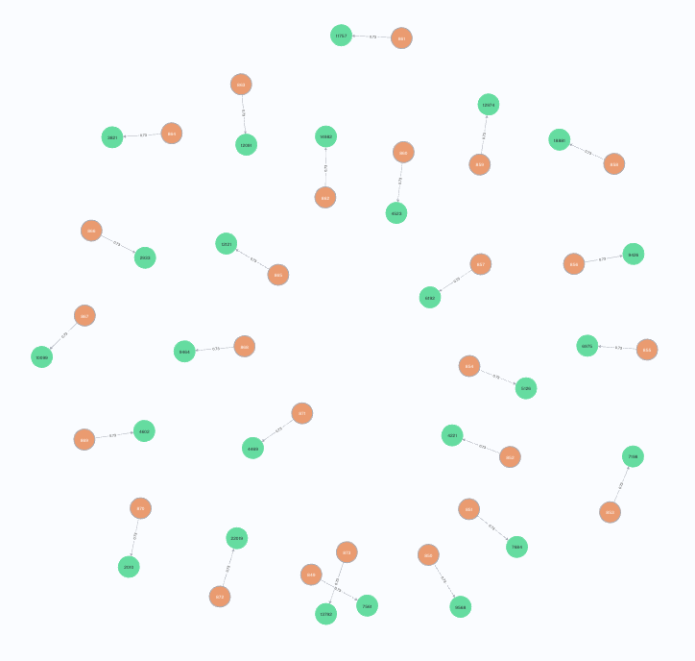
NEO4J
After first try of correlation Heatmap.
We can build a structure, based on positive coof, which is showing relations between columns.
This analyze can show insights, which can be useful.
We can suggest, that Channel and Region is only one and smallest connection between data. At all, it all being separate on two parts

Slide 10
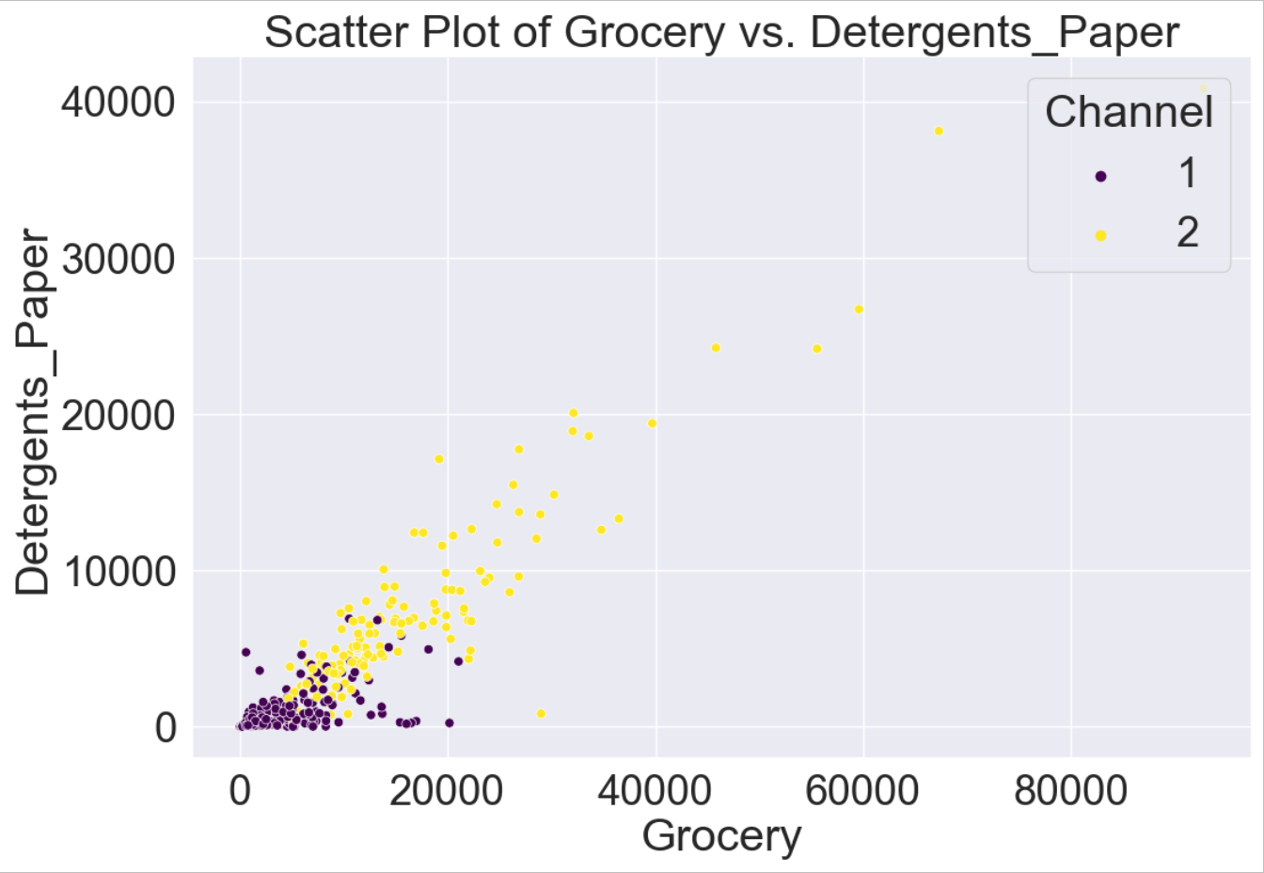
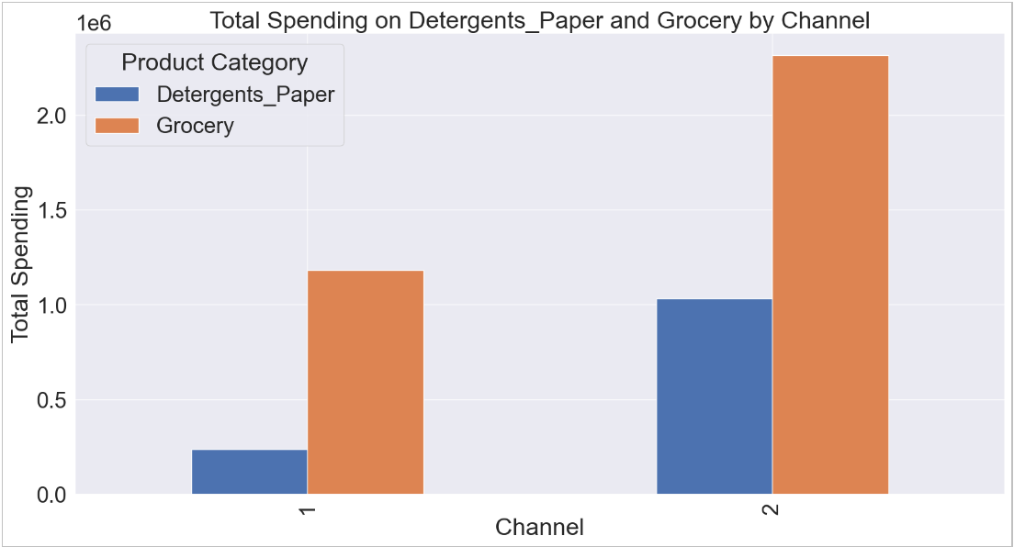
0.92 coof
Channel 1: Most data points from Channel 1 have low to moderate spending on both 'Grocery' and 'Detergents_Paper', suggesting that customers from this channel typically spend less on these categories.
Channel 2: In Channel 2, there are data points that exhibit higher spending on both 'Grocery' and 'Detergents_Paper'. This channel may represent larger retail or supermarket-type customers who purchase more of these products.
In summary, this scatter plot provides valuable insights into the relationship between 'Grocery' and 'Detergents_Paper' expenditures while also highlighting the distinct spending patterns of customers from different distribution channels. Channel 2 customers tend to spend more on both product categories, while Channel 1 customers exhibit lower spending on average.

Slide 11
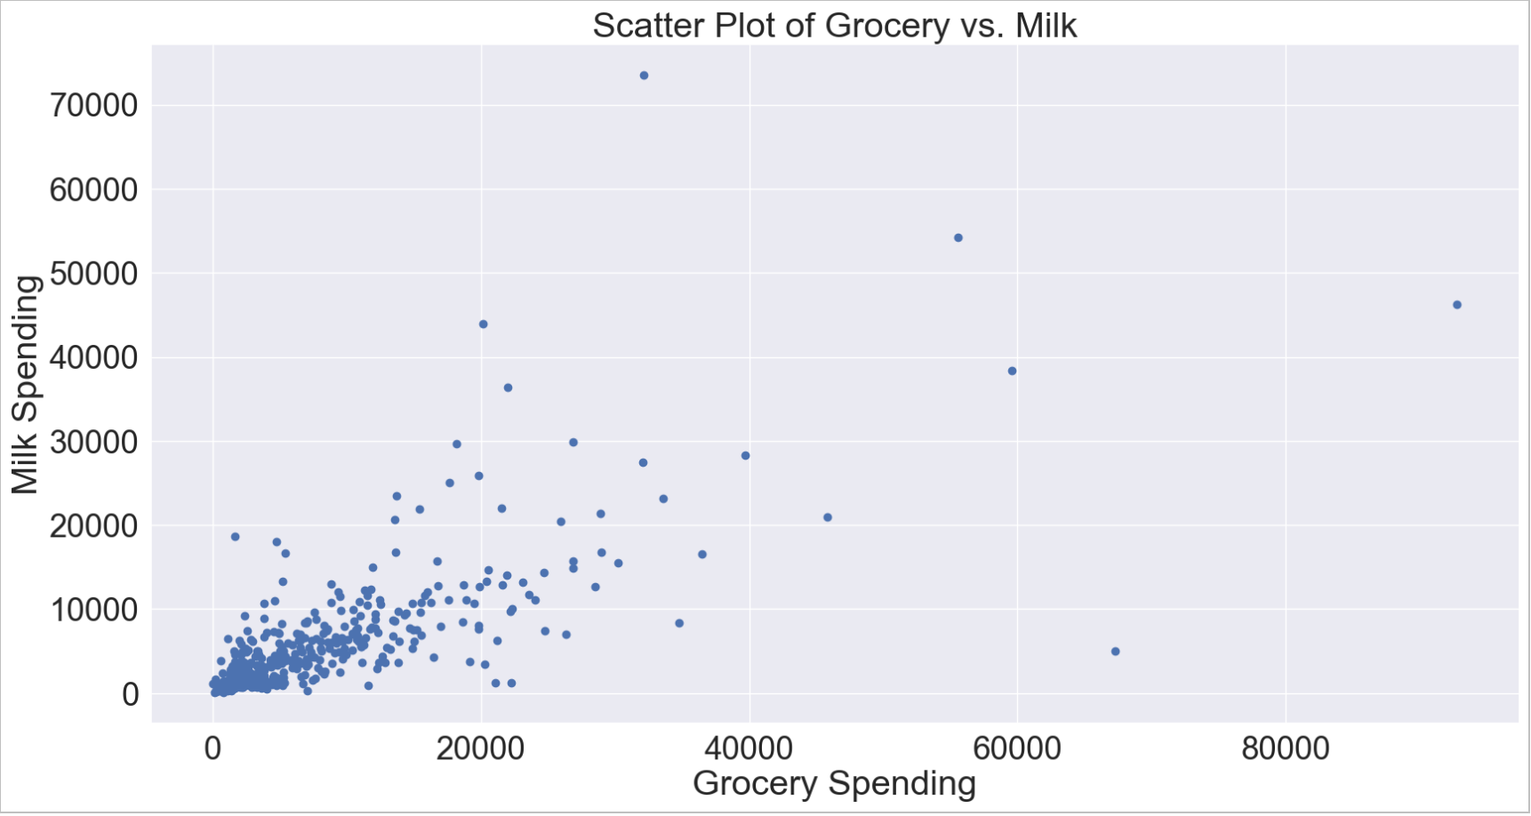
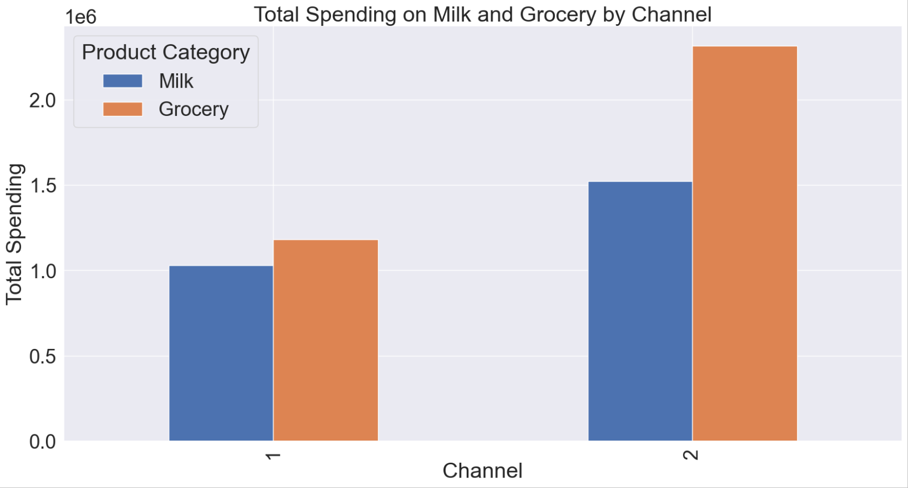
0.73 coof
The scatter plot of "Grocery" vs. "Milk" displays individual data points based on their spending on these two product categories. Here's the conclusion for this plot:
Positive Correlation: The plot shows a positive correlation between spending on "Grocery" and "Milk." As customers spend more on "Grocery," they tend to spend more on "Milk," and vice versa. The data points are generally clustered around a diagonal line that slopes upward, indicating this positive relationship.
Total Spending on Milk and Grocery by Channel: The bar chart visualizes the total spending on "Milk" and "Grocery" by different distribution channels. Here's the conclusion for this plot:
Channel Comparison:
Channel 1: This channel has significantly lower total spending on both "Milk" and "Grocery" compared to Channel 2.
Channel 2: Channel 2 exhibits significantly higher total spending on both "Milk" and "Grocery" compared to Channel 1. This suggests that Channel 2 represents larger customers or businesses with higher overall expenditures on these product categories.
In summary, the scatter plot illustrates the positive correlation between "Grocery" and "Milk" spending, while the bar chart highlights the substantial differences in total spending on these product categories between the two distribution channels, with Channel 2 having much higher total spending than Channel 1.

Slide 12
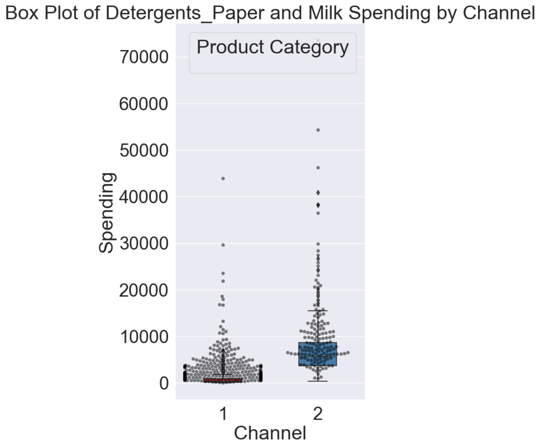
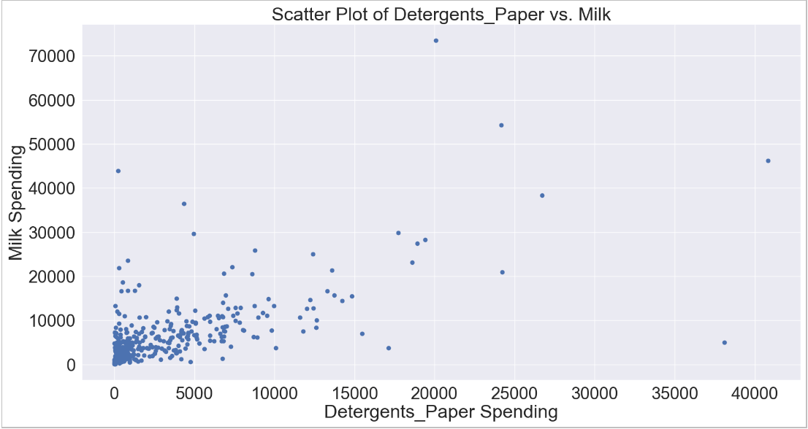
0.66 coof
Detergents_Paper Spending:
For Channel 1, the box plot shows a relatively small interquartile range (IQR) for 'Detergents_Paper' spending, indicating that the spending in this category is concentrated within a relatively narrow range. There are a few outliers representing exceptionally high spending in this category within Channel 1.
For Channel 2, the box plot indicates a wider IQR for 'Detergents_Paper' spending, suggesting that spending in this category varies more within this channel. There are also outliers indicating some very high spending on 'Detergents_Paper' in Channel 2.
Milk Spending:
For both Channel 1 and Channel 2, the swarm plot shows individual data points for 'Milk' spending. The points are distributed across a range of values, with some data points exhibiting higher spending on 'Milk' and others having lower spending. There is no significant difference in the distribution of 'Milk' spending between the two channels.
Channel Distinction:
When comparing the two channels, it's evident that Channel 2 has a wider range of spending in the 'Detergents_Paper' category compared to Channel 1. This indicates that customers in Channel 2 have more diverse spending patterns in this category, with both low and high spenders.
In terms of 'Milk' spending, both channels have a similar distribution pattern, and there's no substantial difference in the range of spending.
In summary, this plot helps visualize the distribution of spending on 'Detergents_Paper' and 'Milk' by different distribution channels. It shows that 'Detergents_Paper' spending varies more in Channel 2, with some exceptionally high spenders, while 'Milk' spending appears to have a similar distribution in both channels.

Slide 13
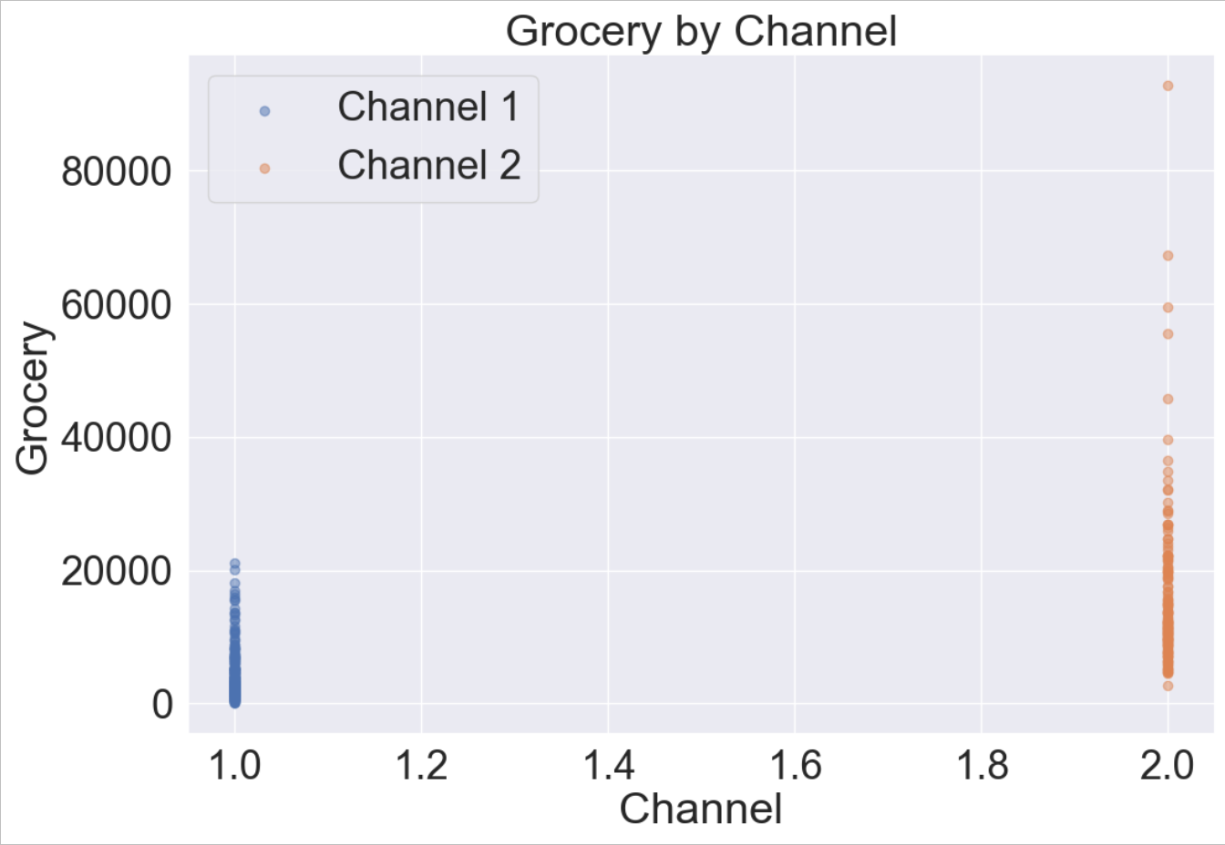
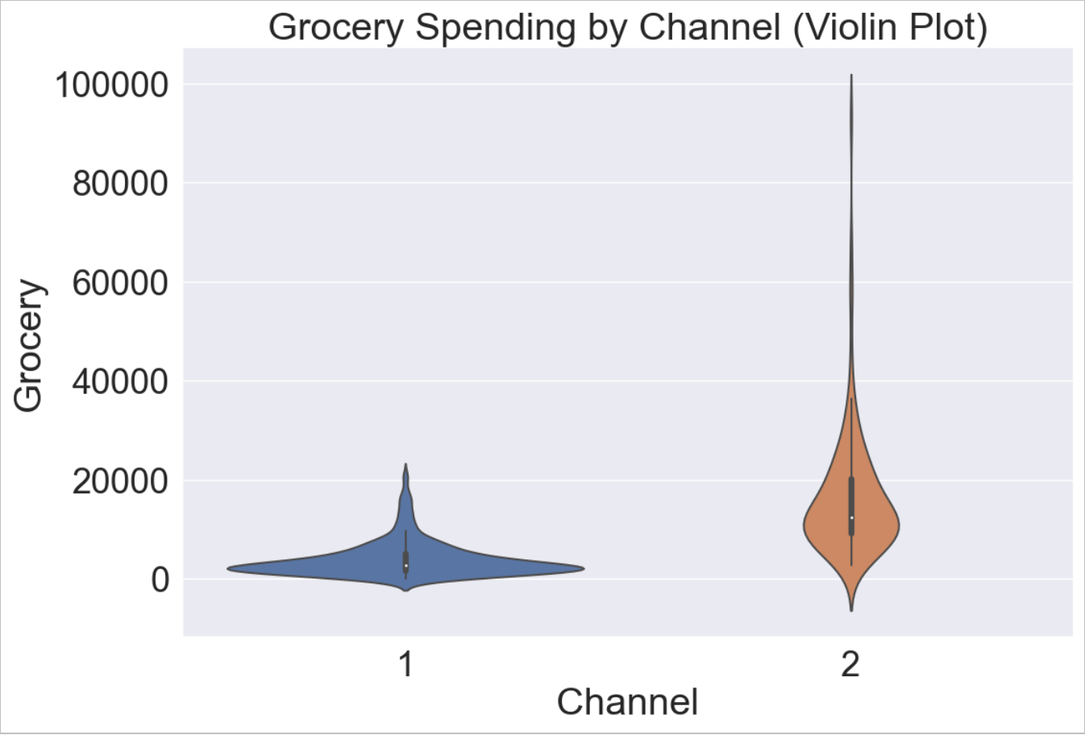
0,61 coof
Channel Comparison:
The plot effectively distinguishes between Channel 1 and Channel 2 with different colors and labels. Channel 1 (labeled as 'Channel 1') is represented by one set of data points, which are generally clustered together on the lower end of the spending scale for 'Grocery.' Channel 2 (labeled as 'Channel 2') is represented by another set of data points that are more scattered but tend to have higher spending on 'Grocery.' Channel Distinction: This plot clearly illustrates that Channel 2 customers generally have significantly higher spending on 'Grocery' compared to Channel 1. Channel 1 customers, on the other hand, typically have lower spending in this category.
In summary, this scatter plot effectively shows the distinction in 'Grocery' spending between Channel 1 and Channel 2, with Channel 2 customers being the larger spenders in this product category.
Distribution Comparison: The violin plot provides a clear comparison of the distribution of 'Grocery' spending between Channel 1 and Channel 2. For Channel 1 (represented on the left side of the plot), the violin plot is narrower, indicating that spending on 'Grocery' is concentrated within a relatively smaller range. This suggests that Channel 1 customers typically have more consistent and lower spending on 'Grocery.' For Channel 2 (represented on the right side of the plot), the violin plot is wider, indicating a broader range of 'Grocery' spending. This suggests that Channel 2 customers have more diverse spending patterns in this category, with both low and high spenders. Central Tendency: The white dot inside each violin represents the median spending for 'Grocery' in each channel. In this plot, you can see that the median spending for 'Grocery' is higher for Channel 2 compared to Channel 1. Density Estimation: The width of the violin plot at different levels represents the density of data points. Wider sections indicate higher density, while narrower sections indicate lower density.
In summary, the violin plot effectively shows the distribution of 'Grocery' spending for both Channel 1 and Channel 2, illustrating that Channel 2 has a wider and more varied distribution of spending in this category compared to the more concentrated spending pattern in Channel 1

Slide 14
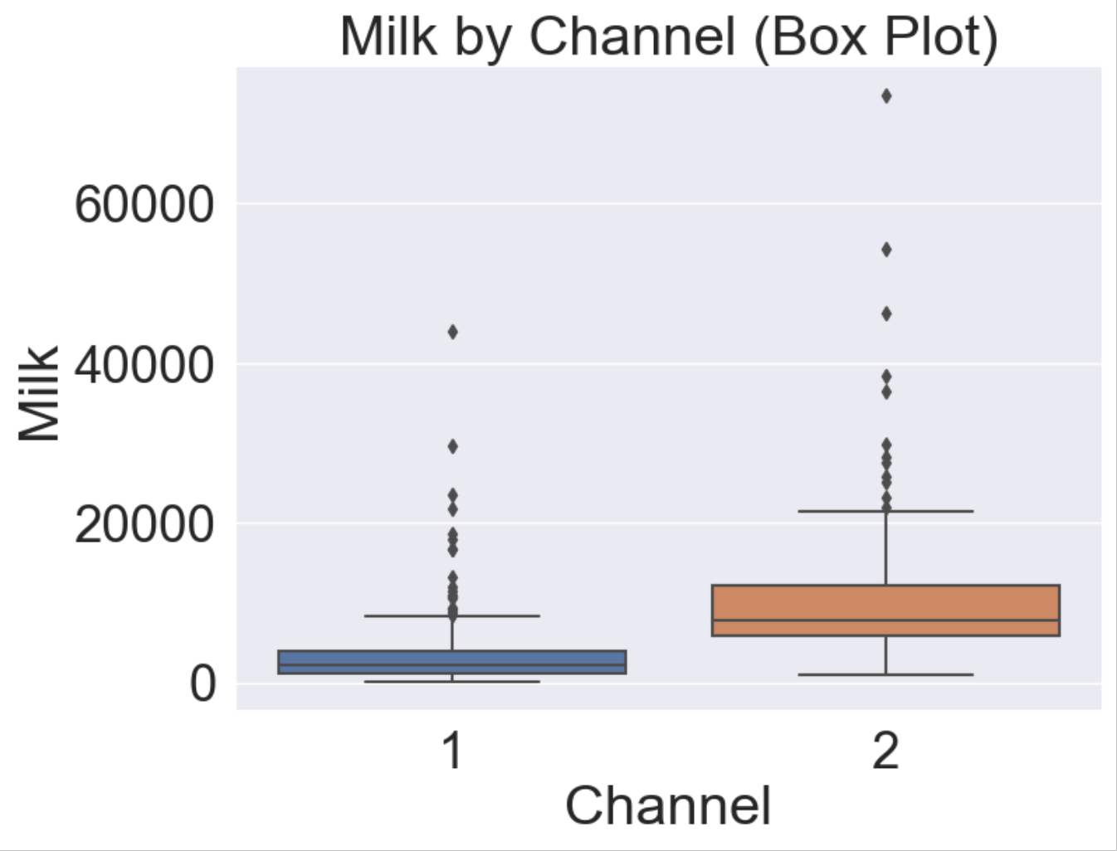
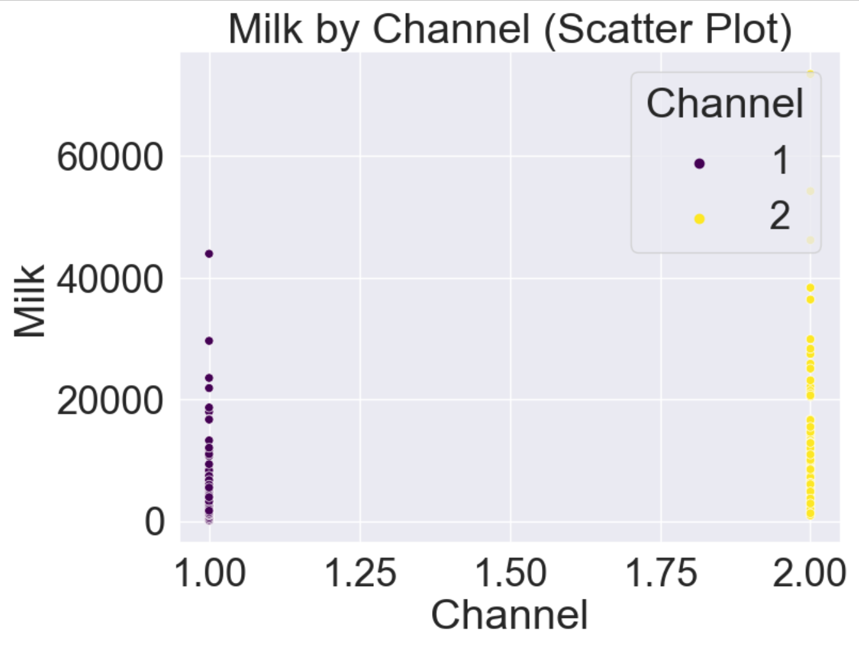
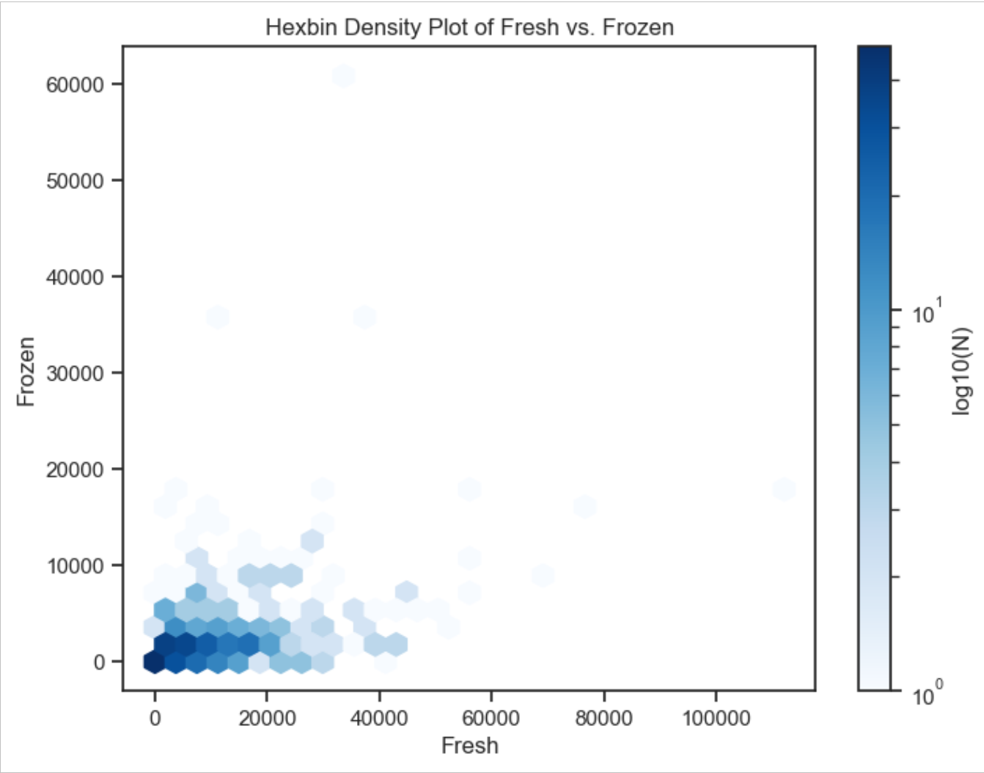
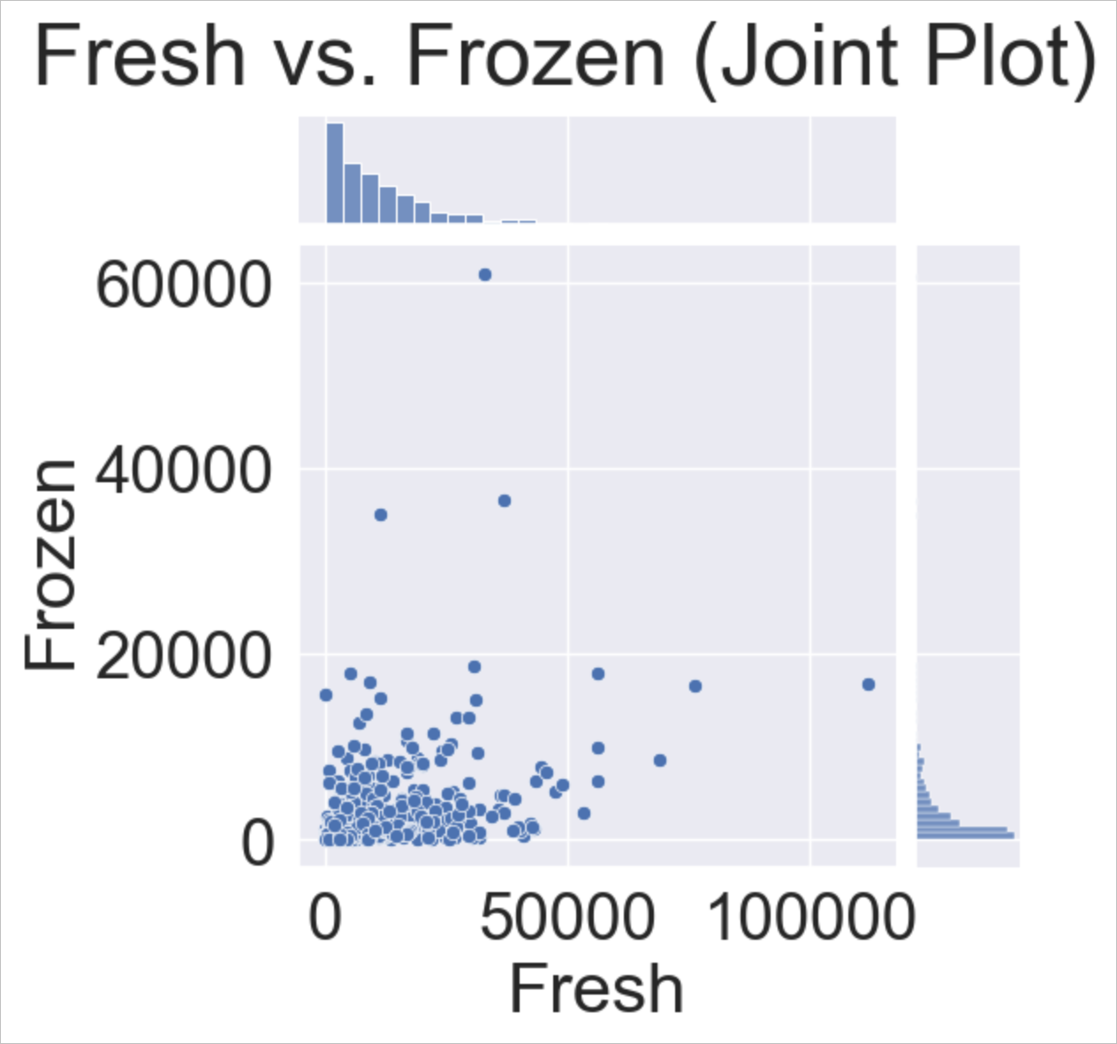
0.46 coof
0.35 coof
Methodology

Slide 15
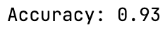
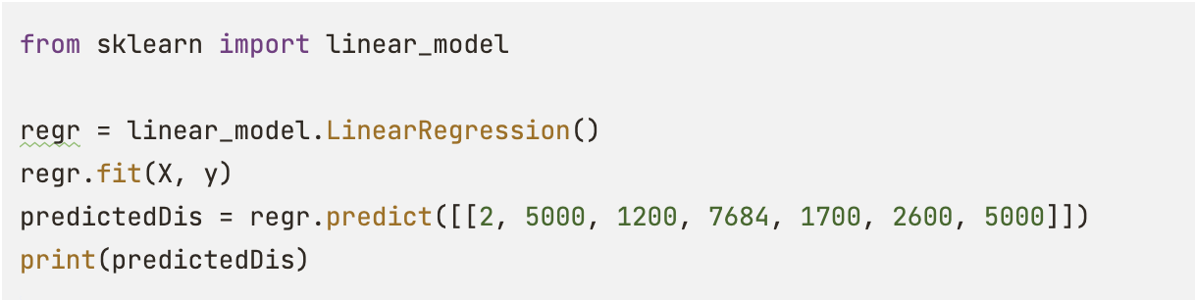
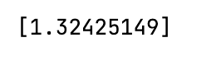
LinearRegression model
On given dataset
It’s possible to perform LinearRegression model to predict results one of the variables, by analyzing different.
Result:
What means ‘Channel of distribution’

Slide 16
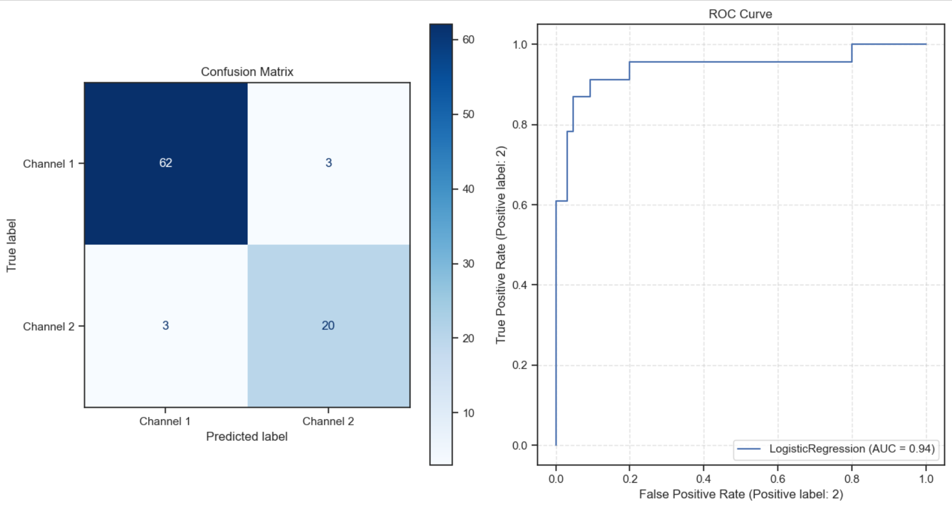
ROC Curve and Confusion Matrix
of Linear Regression

Slide 17
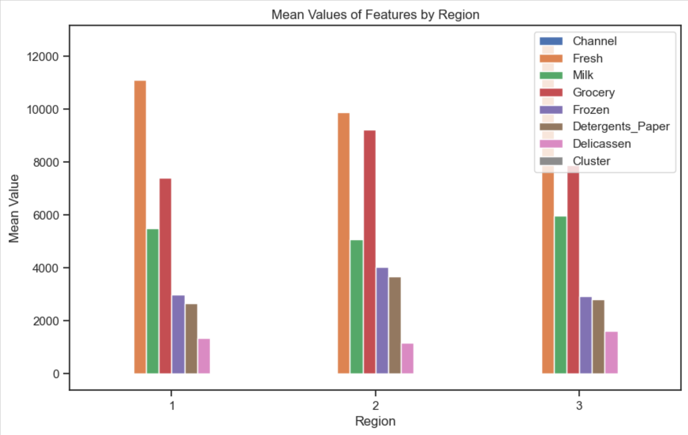
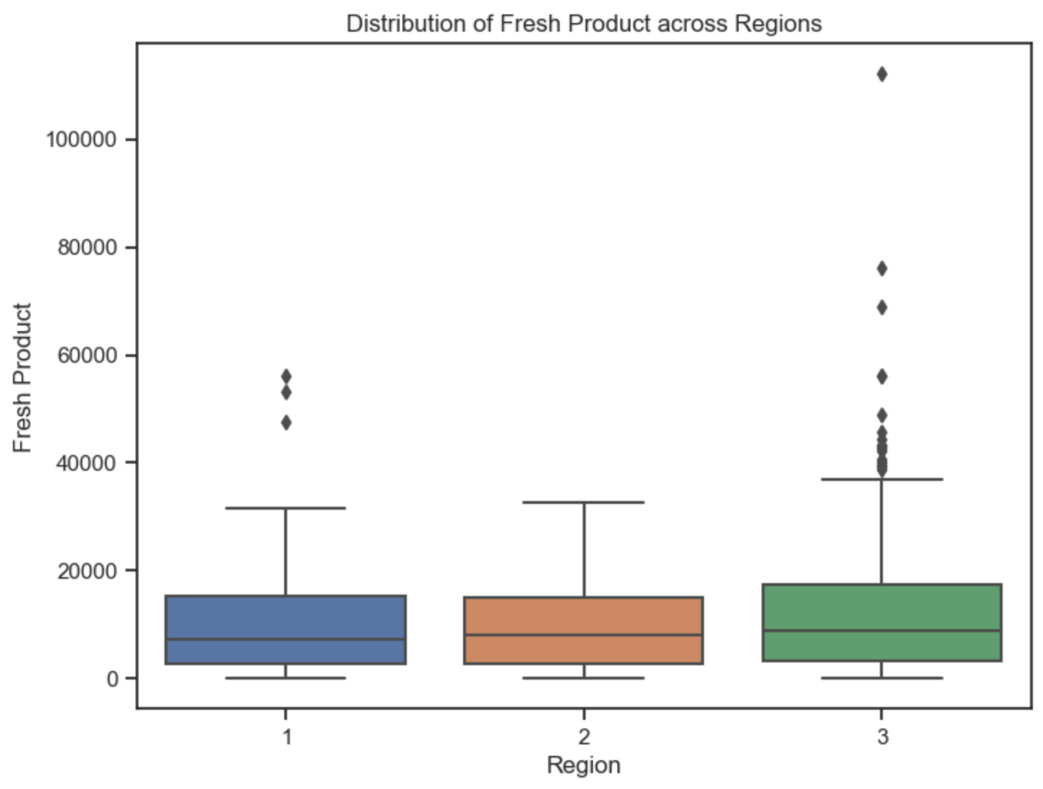
Region affect

Slide 18
Conclusion and Discussion
In conclusion, the analysis of the customer purchasing behavior dataset has unveiled valuable insights into the dynamics of customer spending across different sales channels and product categories.
Visualizations and statistical techniques have exposed variations in preferences and patterns that are pivotal for businesses seeking to optimize their marketing and distribution strategies. By identifying distinct behaviors within each sales channel and product category, companies can tailor their approaches to better meet customer needs.
As a variable, Region (which present theoretical area of human living) has a low Heatmap coefficient to another variables. Despite that, it can be used to characterize a set of columns, which will present preferences of people in area. Geographical location, size of territory, nature of the relief and climate are columns, which is not present in dataset, but can be important to review Region and understand people’s preferences of products.
Potential future research may involve deeper regional analyses, advanced machine learning models for customer segmentation, and exploration of additional factors influencing customer behavior.

Slide 19
References
Web site Modern Education and Computer Science PRESS https://www.mecs-press.org/index.html B.Jaya Lakshmi, K.B.Madhuri, M.Shashi, "An Efficient Algorithm for Density Based Subspace Clustering with Dynamic Parameter Setting", International Journal of Information Technology and Computer Science(IJITCS), Vol.9, No.6, pp.27-33, 2017. DOI:10.5815/ijitcs.2017.06.04
Web site IEEE Access https://ieeexplore.ieee.org/Xplore/home.jsp Y. Yang and N. Li, "Research on Residents’ Travel Behavior Based on Multiple Logistic Regression Model," in IEEE Access, vol. 11, pp. 74759-74767, 2023, doi: 10.1109/ACCESS.2023.3297497.
Web site IEEE Access https://ieeexplore.ieee.org/Xplore/home.jsp Y. -X. Wu, Z. -N. Hu, Y. -Y. Wang and F. Min, "Rare Potential Poor Household Identification With a Focus Embedded Logistic Regression," in IEEE Access, vol. 10, pp. 32954-32972, 2022, doi: 10.1109/ACCESS.2022.3161574.
https://www.amazon.com/Neo4j-Action-Aleksa-Vukotic/dp/1617290769
Neo4J in Action
Author: Jonas Partner, Aleksa Vukotic, and Nicki Watt
https://onlinelibrary.wiley.com/doi/book/10.1002/9781119055259
Storytelling with data: a data visualization guide for business professionals
Author: Cole Nussbaumer Knaflic
https://clauswilke.com/dataviz/
Fundamentals of Data Visualization: A primer on making Informative and Compelling Figures
Author: Claus O. Wilke
https://cup.columbia.edu/book/better-data-visualizations/9780231193115
Better Data Visualizations: A Guide for Scholars, Researchers, and Wonks
Author: Jonathan Schwabish
https://www.edwardtufte.com/tufte/books_vdqi
The visual display of quantitative information
Author: Edward R. Tufte

